Slide 1
Projecting the age distribution of PWH in the US: initial results
Andrew Zalesak & Melissa Schnure

Slide 2
Objectives
Characterize changes in the age distribution of PLWH in the US from 2025-2040
Compare median age and number PLWH over age 55 across states

Slide 3
Methods
Project calibrated state-level models out to 2040 with no intervention
Later, we may introduce an intervention to compare to baseline
Notes:
Will be re-calibrating with a smoother spline function for sexual transmission rates to keep incidence projections reasonable
→ MS: Moved to notes; I don’t think we have to mention that here

Slide 4
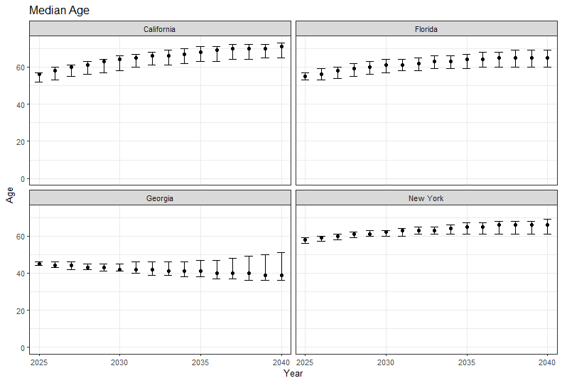


Results: Median Age
2040:
65 (60-69)
2025:
55 (53-57)
2025:
58 (56-59)
2040:
66 (61-69)
2025:
45 (44-46)
2040:
39 (36-51)

Slide 5
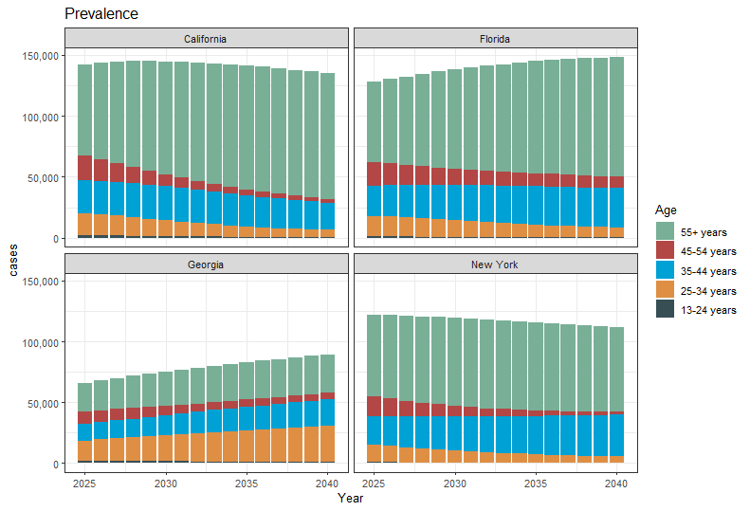
Results: Prevalence Trends by Age

Slide 6
New Results: Summary
Measure | Median Age |  |  |  | Number Age 55+ |  |  |  | Proportion Age 55+
Outcome | Diagnosed Prevalence |  | New Diagnoses |  | Diagnosed Prevalence |  | New Diagnoses |  | Diagnosed Prevalence |  | New Diagnoses
Year | 2025 | 2040 | 2025 | 2040 | 2025 | 2040 | 2025 | 2040 | 2025 | 2040 | 2025 | 2040
CA | 54 | 67 | 34 | 37 | 70,034 | 89,363 | 417 | 283 | 50% | 67% | 13% | 20%
 | [52-56] | [63-70] | [33-35] | [35-39] | [65,956-74,277] | [78,383-100,109] | [362-501] | [193-414] | [47-53%] | [59-75%] | [11-15%] | [14-29%]
FL | 55 | 65 | 35 | 37 | 64,641 | 90,526 | 519 | 394 | 51% | 64% | 16% | 24%
 | [53-57] | [60-70] | [34-36] | [34-42] | [61,181-68,566] | [80,767-106,063] | [445-603] | [245-600] | [48-54%] | [56-75%] | [14-18%] | [16-36%]
TX | 46 | 47 | 32 | 32 | 38,682 | 58,729 | 373 | 389 | 36% | 47% | 10% | 14%
 | [45-47] | [42-61] | [31-32] | [31-35] | [35,915-41,236] | [50,022-71,931] | [321-436] | [270-560] | [34-38%] | [39-58%] | [9-12%] | [9-20%]
GA | 45 | 43 | 31 | 32 | 23,841 | 33,242 | 207 | 168 | 37% | 45% | 10% | 15%
 | [44-47] | [41-64] | [31-32] | [31-35] | [21,933-26,114] | [25,816-39,222] | [172-248] | [101-270] | [34-41%] | [35-58%] | [9-12%] | [8-26%]
IL | 49 | 60 | 33 | 35 | 15,200 | 17,807 | 108 | 79 | 43% | 56% | 12% | 19%
 | [47-51] | [46-68] | [32-33] | [32-40] | [14,206-16,345] | [15,471-20,933] | [87-139] | [47-125] | [40-46%] | [47-70%] | [10-15%] | [10-33%]
LA | 47 | 55 | 32 | 32 | 8,627 | 12,833 | 74 | 58 | 39% | 51% | 11% | 11%
 | [45-49] | [43-65] | [31-33] | [30-35] | [7,909-9,406] | [10,189-16,089] | [59-91] | [37-90] | [36-42%] | [40-65%] | [8-13%] | [6-18%]
MO | 49 | 44 | 31 | 32 | 5,955 | 7,348 | 44 | 43 | 43% | 47% | 9% | 12%
 | [46-51] | [39-64] | [31-32] | [31-34] | [5,473-6,456] | [6,015-8,672] | [36-56] | [29-63] | [40-47%] | [35-59%] | [7-12%] | [7-19%]
AL | 44 | 41 | 32 | 32 | 5,083 | 6,139 | 69 | 54 | 34% | 32% | 12% | 12%
 | [43-46] | [38-46] | [31-33] | [31-34] | [4,570-5,474] | [4,767-8,168] | [41-78] | [28-73] | [30-37%] | [25-47%] | [7-14%] | [5-17%]
MS | 47 | 46 | 32 | 33 | 3,859 | 5,260 | 42 | 32 | 38% | 44% | 10% | 9%
 | [46-48] | [43-58] | [30-33] | [31-36] | [3,532-4,172] | [4,325-6,461] | [33-51] | [20-51] | [35-41%] | [38-53%] | [8-13%] | [5-14%]
WI | 49 | 41 | 31 | 31 | 3,182 | 4,212 | 22 | 25 | 44% | 43% | 10% | 10%
 | [48-52] | [38-60] | [30-32] | [30-32] | [2,976-3,409] | [3,700-4,774] | [15-28] | [11-42] | [41-47%] | [37-53%] | [7-13%] | [4-15%]

Slide 7
Questions for You
Should we look at all U.S. states, or deep-dive into a few?
Interventions?
Is the interaction with race/sex worth exploring?
Other ideas for figures?

Slide 8
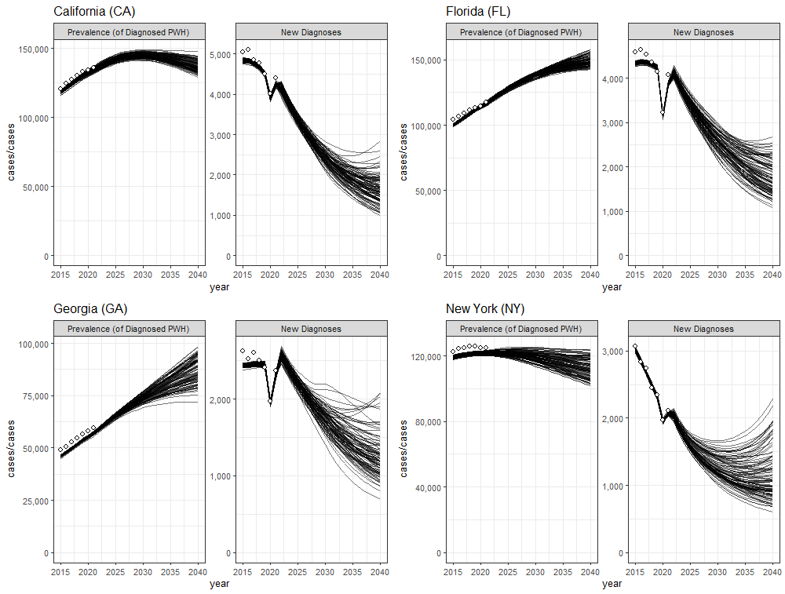

Slide 9
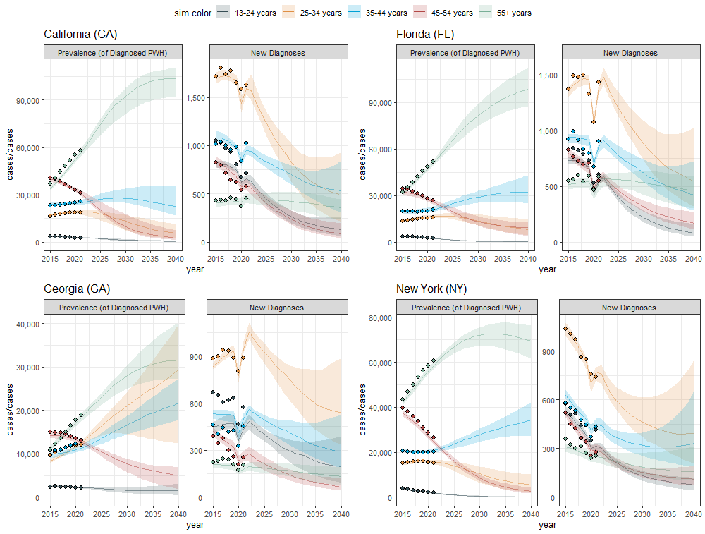

Slide 10
Old Results: Summary
Measure | Median Age |  |  |  | Number Age 55+ |  |  |  | Proportion Age 55+
Outcome | Diagnosed Prevalence |  | New Diagnoses |  | Diagnosed Prevalence |  | New Diagnoses |  | Diagnosed Prevalence |  | New Diagnoses
Year | 2025 | 2040 | 2025 | 2040 | 2025 | 2040 | 2025 | 2040 | 2025 | 2040 | 2025 | 2040
CA | 56 | 71 | 34 | 37 | 74,500 | 103,725 | 439 | 359 | 0.53% | 0.76% | 0.13% | 0.23%
 | [52-57] | [65-73] | [33-35] | [34-41] | [67,434-78,111] | [91,815-110,442] | [383-511] | [231-448] | [0.47-0.55%] | [0.65-0.83%] | [0.12-0.15%] | [0.14-0.35%]
FL | 55 | 65 | 35 | 38 | 65,732 | 98,583 | 561 | 465 | 0.51% | 0.67% | 0.16% | 0.28%
 | [53-57] | [60-69] | [34-36] | [35-44] | [61,490-69,998] | [87,783-112,236] | [488-619] | [299-584] | [0.48-0.54%] | [0.57-0.75%] | [0.14-0.18%] | [0.16-0.4%]
GA | 45 | 39 | 31 | 32 | 23,218 | 31,567 | 186 | 131 | 0.35% | 0.36% | 0.08% | 0.10%
 | [44-46] | [36-51] | [31-32] | [31-34] | [21,335-24,160] | [27,150-40,188] | [157-221] | [76-192] | [0.33-0.37%] | [0.3-0.49%] | [0.07-0.1%] | [0.05-0.2%]
NY | 58 | 66 | 34 | 36 | 66,908 | 69,530 | 221 | 159 | 0.55% | 0.62% | 0.14% | 0.14%
 | [56-59] | [61-69] | [33-35] | [33-38] | [64,017-68,813] | [61,541-76,228] | [179-274] | [102-313] | [0.53-0.56%] | [0.56-0.69%] | [0.12-0.17%] | [0.1-0.21%]

Slide 11
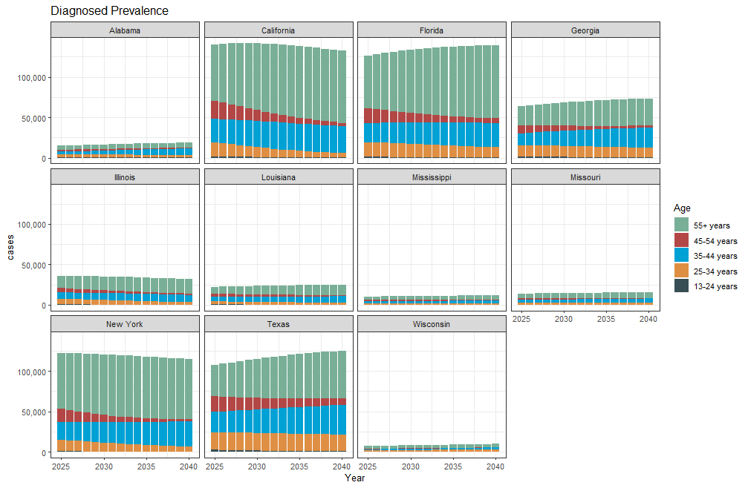

Slide 12
